Slide 1
Priority Queues

Slide 2
The ADT Priority Queue
Organize data by priorities
  Example: weekly “to do” list
Priority value
  We will say high value ⇨ high priority
Operations
  Test for empty
  Add to queue in sorted position
  Remove/get entry with highest priority

Slide 3
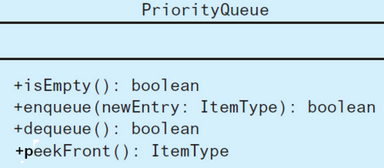
The ADT Priority Queue
FIGURE 13-4 UML diagram for the class PriorityQueue

Slide 4
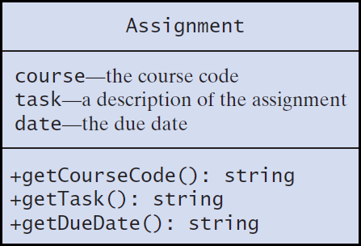
Tracking Your Assignments
UML diagram for the class Assignment

Slide 5
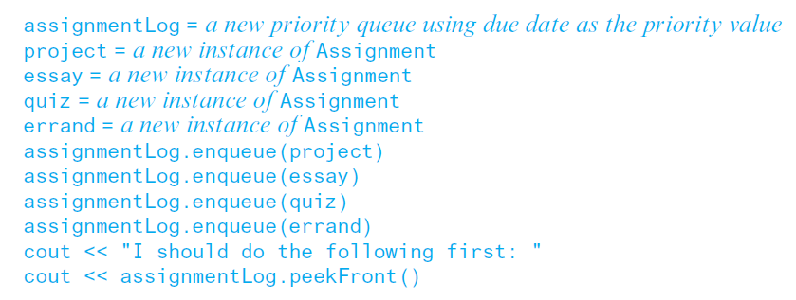
Tracking Your Assignments
Pseudocode to organize assignments, responsibilities

Slide 6
Application: Simulation
Simulation models behavior of systems
Problem to solve
  Approximate average time bank customer must wait for service from a teller
  Decrease in customer wait time with each new teller added

Slide 7
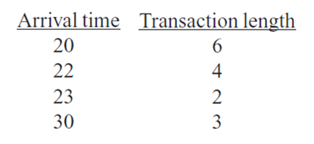
Application: Simulation
Sample arrival and transaction times

Slide 8
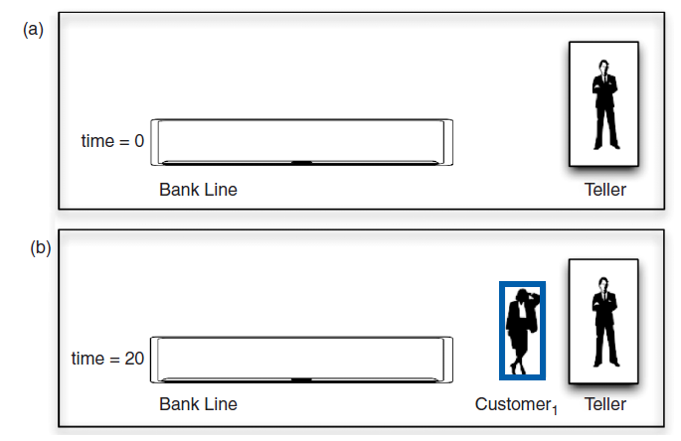
Application: Simulation
A bank line at time (a) 0; (b) 20; (c) 22; (d) 26

Slide 9
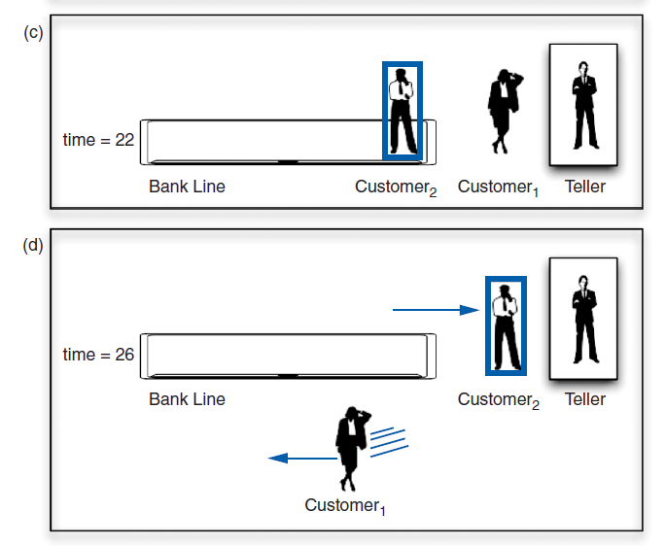
Application: Simulation
A bank line at time (a) 0; (b) 20; (c) 22; (d) 26

Slide 10
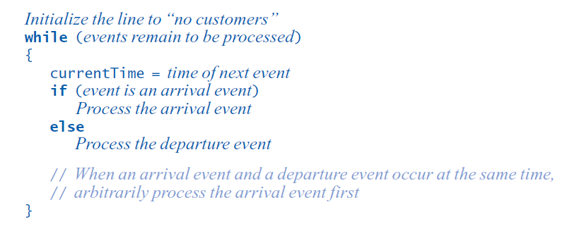
Application: Simulation
Pseudocode for an event loop

Slide 11
Application: Simulation
Time-driven simulation
  Simulates the ticking of a clock
Event-driven simulation considers
  Only the times of certain events,
  In this case, arrival-s and departures
Event list contains
  All future arrival and departure events

Slide 12
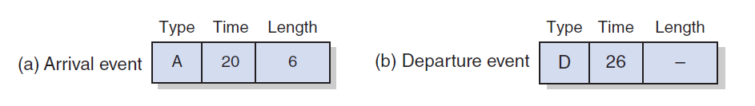
Application: Simulation
A typical instance of (a) an arrival event;
(b) a departure event

Slide 13
Application: Simulation
Two tasks required to process each event
  Update the bank line: Add or remove customers.
  Update the event queue: Add or remove events.
New customer
  Always enters bank line
  Served while at the front of the line

Slide 14
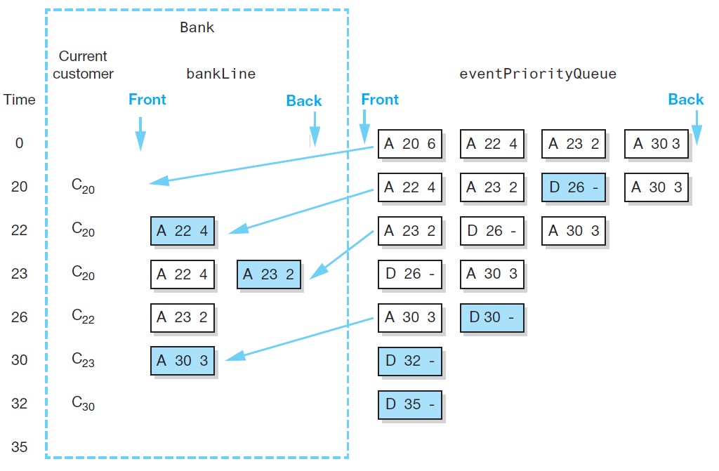
Application: Simulation
A trace of the bank simulation algorithm for the data (20, 6), (22, 4),
(23, 2), (30, 3)

Slide 15
Position-Oriented and
Value-Oriented ADTs
Position-oriented ATDs
  Stack, list, queue
Value-oriented ADTs
  Sorted list

Slide 16
Position-Oriented and
Value-Oriented ADTs
Comparison of stack and queue operations
  isEmpty for both
  pop and dequeue
  peek and peekFront

Slide 17
Position-Oriented and
Value-Oriented ADTs
ADT list operations generalize stack and queue operations
  getLength
  insert
  remove
  getEntry

